Slide 1

MALICIOUS APPLICATION DETECTION USING SVM
Date: 17 MAY 2021
A.MEGHANA : 17WH1A0558
K.KRISHNA SIRI : 17WH1A0560
B.CHINMAI : 17WH1A0506
Internal Guide: Dr. G. NAGA SATISH
Designation : Professor
Department of Computer Science & Engineering
BVRIT HYDERABAD College of Engineering for Women

Slide 2
Abstract
In recent years, the usages of smart phones are increasing steadily and also growth of Android application users are increasing. Due to growth of Android application user, some intruder are creating malicious android application as tool to steal the sensitive data and identity theft / fraud mobile bank, mobile wallets. There are so many malicious applications detection tools and software are available. But an effectively and efficiently malicious applications detection tools needed to tackle and handle new complex malicious apps created by intruder or hackers. We came up with idea of using machine learning approaches for detecting the malicious android application. First we have to gather dataset of past malicious apps as training set and with the help of Support vector machine algorithm and decision tree algorithm make up comparsion with training dataset and trained dataset we can predict the malware android apps upto 93.2 % unknown / New malware mobile application.
BVRIT HYDERABAD College of Engineering for Women

Slide 3
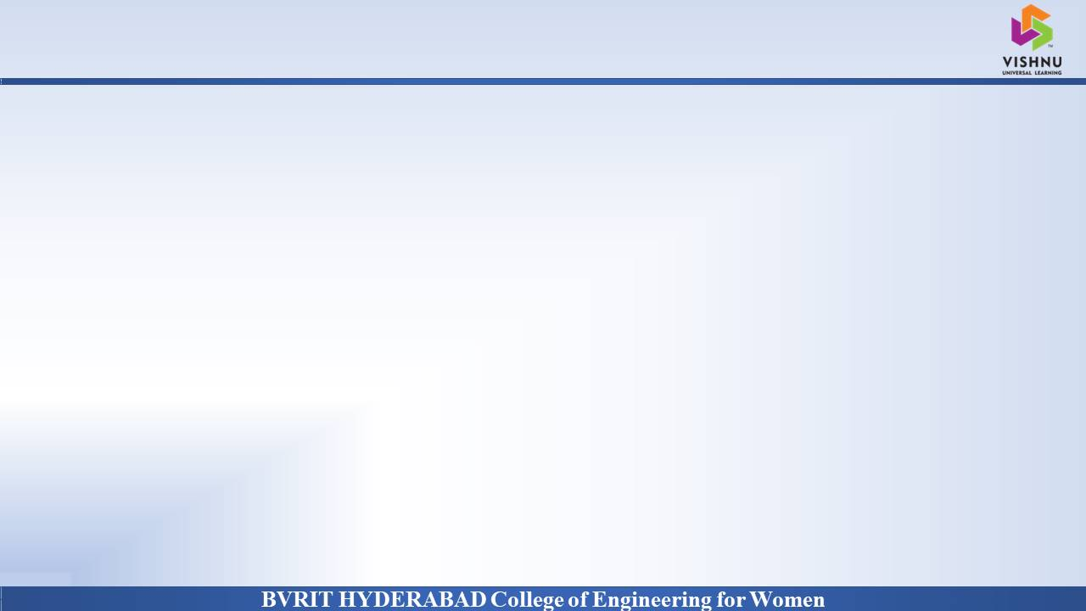
Dataset
Why Should I Study this course?
Attribute | Description
cpu-usage | CPU utilization
context-switch | The process of storing the state of a process or thread
cpu-migration | Moving a virtual CPU from one queue to another
page-faults | It occurs when a program attempts to access a block of memory that is not stored in RAM
cycles-GHz | Clock speed is the rate at which a processor can complete a processing cycle. It is typically measured in gigahertz
Examples
BVRIT HYDERABAD College of Engineering for Women

Slide 4
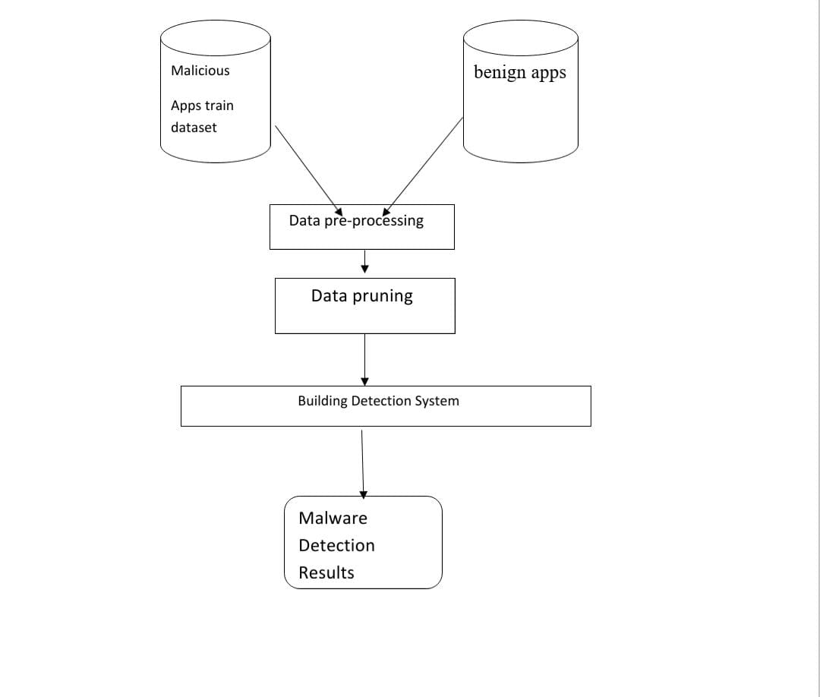
Architecture
n
BVRIT HYDERABAD College of Engineering for Women

Slide 5
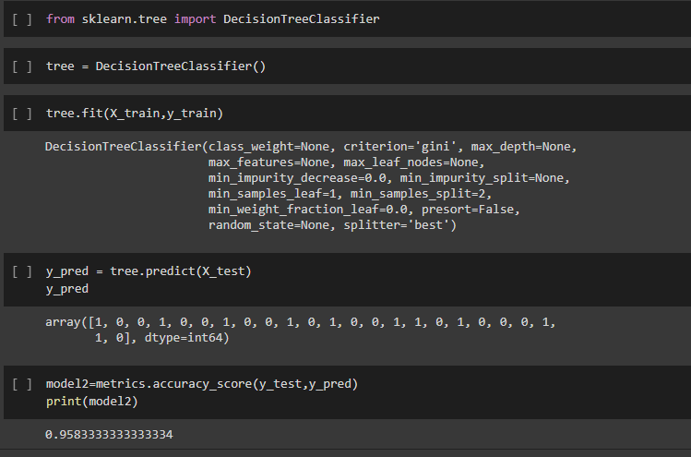
n
BVRIT HYDERABAD College of Engineering for Women

Slide 6
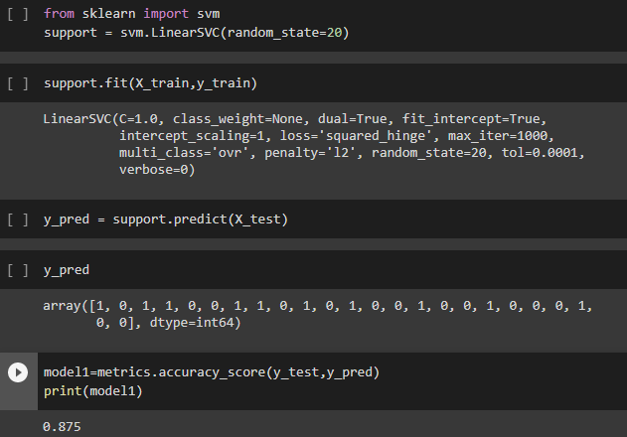
BVRIT HYDERABAD College of Engineering for Women

Slide 7
Technology Stack
SVM
python
Libraries Used:
Numpy
Matplotlib
Pandas
Seaborn
Sklearn
BVRIT HYDERABAD College of Engineering for Women

Slide 8
System Requirements
Environment | Specifications
Hardware | Windows 10 64 bit RAM 8GB
Software | Data Set Anaconda Python Libraries
VF
BVRIT HYDERABAD College of Engineering for Women

Slide 9
References
1. A. P. Felt, K. Greenwood, and D. Wagner, “The eﬀectiveness of install-time permission systems for third-party applications”,2010.
2. B. P. Sarma, N. Li, C. Gates, R. Potharaju, C. Nita-Rotaru, and I. Molloy, “Android permissions: a perspective combining risks and beneﬁts”, 2012.
3. Y. Zhou and X. Jiang, “Dissecting android malware: Characterization and evolution”,2012.
4. V. Rastogi, Y. Chen, and X. Jiang, “Droidchameleon: evaluating android anti-malware against transformation attacks”, 2013.
5. G. Canfora, F. Mercaldo, and C. A. Visaggio, “A classiﬁer of malicious android applications”, 2013.
BVRIT HYDERABAD College of Engineering for Women

Slide 10
Thankyou
BVRIT HYDERABAD College of Engineering for Women

